Slide 1
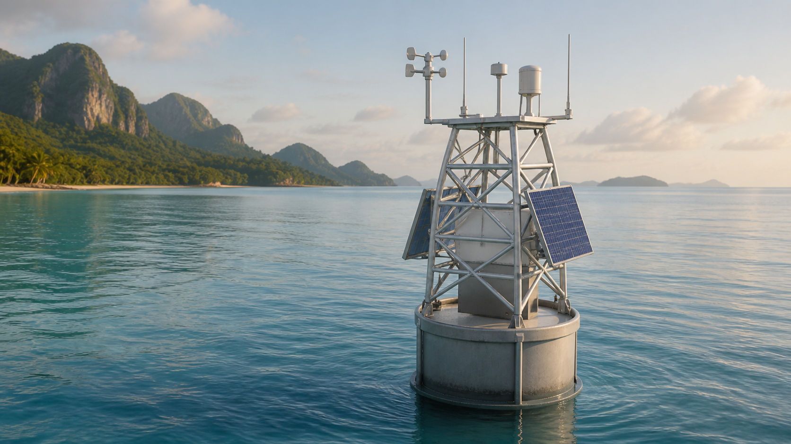
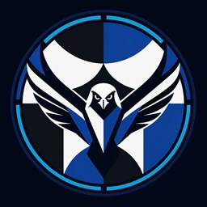
PROJECT FALCON
Fullbright College's AI-powered
Live Coastal Observation Network
An affordable solar-powered smart buoy for localized coastal monitoring, edge processing, and responsible short-horizon prediction research.
IDEA • SOFTWARE PROTOTYPE • FUNDING PROPOSAL
CONCEPT VISUALIZATION
Notes:
Magandang araw po. Kami ang Project FALCON Research Group from Fullbright College. FALCON is an affordable, solar-powered smart coastal buoy for localized wave monitoring. Today we will present the problem, our proposed solution, our current software progress, and the support needed to build and validate the physical prototype.

Slide 2
WHY THIS MATTERS
02
The gap is affordable, site-specific coastal observation
⌖
Localized conditions
₱
Access and cost
⚠
Operational limits
A wide-area forecast may not describe the exact near-shore research or launch site.
Professional oceanographic systems can be difficult for small institutions to acquire and maintain.
Connectivity, power, maintenance, and equipment displacement complicate continuous monitoring.
THE RESEARCH QUESTION
Can a modular, local-first buoy provide useful coastal observations at a defined Palawan pilot site—at a cost and complexity a small institution can manage?
PROJECT FALCON • FULLBRIGHT COLLEGE
DOST IDEA PRESENTATION
Notes:
The problem is not the absence of official forecasts. The gap we target is affordable, location-specific observation for one defined pilot site. Near-shore conditions can differ from a wider forecast area, while power, connectivity, maintenance, and displacement make continuous monitoring difficult.

Slide 3
PROPOSED SOLUTION
03
A local-first smart coastal observation buoy
◉
Measure
Motion, water pressure, wind, GPS, temperature, battery and solar.
▣
Process locally
ESP32 reads sensors; Orange Pi stores, processes, serves the API, and hosts the dashboard.
⌁
Display and alert
UPPER ELECTRONICS POD
Responsive dashboard presents live values, history, system health, and abnormal displacement alerts.
↗
Research prediction
CONCEPT VISUALIZATION
Actual interactive model available: FALCON-01.glb
Field data will be collected before the model is trained, compared with a baseline, and validated.
PROJECT FALCON • FULLBRIGHT COLLEGE
DOST IDEA PRESENTATION
Notes:
The buoy uses sensors to measure the environment and its own health. The ESP32 is the sensor reader. The Orange Pi is the onboard computer for storage, processing, API services, dashboard, and future validated model inference. Solar and battery power support local operation, while buffering protects data when connectivity is intermittent.

Slide 4
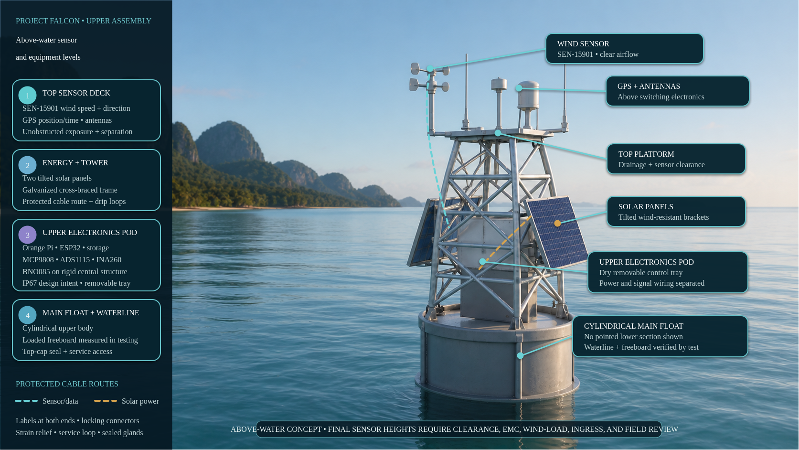
Notes:
This corrected view focuses only on the above-water assembly. Level one contains the wind sensor, GPS, and antennas. Level two covers the solar panels, cross-braced tower, and protected cable routing. Level three identifies the dry upper electronics pod containing the Orange Pi, ESP32, storage, interface boards, and power monitors, with the BNO085 fixed to the rigid central structure. Level four identifies the cylindrical main float, top-cap service access, waterline, and freeboard. No pointed underwater section is shown. Final sensor heights still require clearance, electromagnetic-interference, wind-load, ingress, and field review.

Slide 5
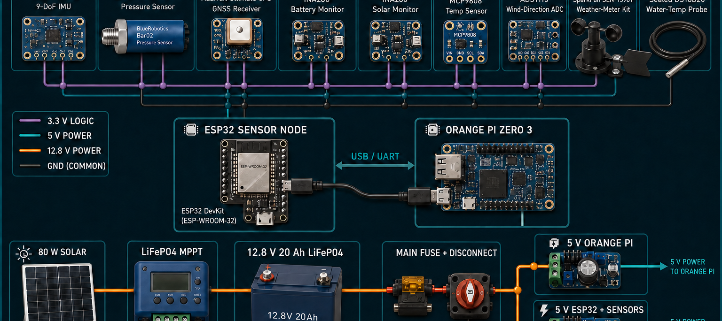
HARDWARE CONCEPT
05
Selected sensors, controllers, and protected power flow
Visual overview only • final wiring follows purchased-board datasheets and the approved pinout.
PROJECT FALCON • FULLBRIGHT COLLEGE
DOST IDEA PRESENTATION
Notes:
This is the electronics overview. BNO085 measures motion, Bar02 measures water pressure, GPS provides position, INA260 boards monitor battery and solar, MCP9808 monitors temperature, and ADS1115 supports the wind-direction input. The ESP32 sends telemetry to the Orange Pi. The lower section shows the proposed protected solar-to-battery power chain. This is a visual guide, not the final installation drawing.

Slide 6
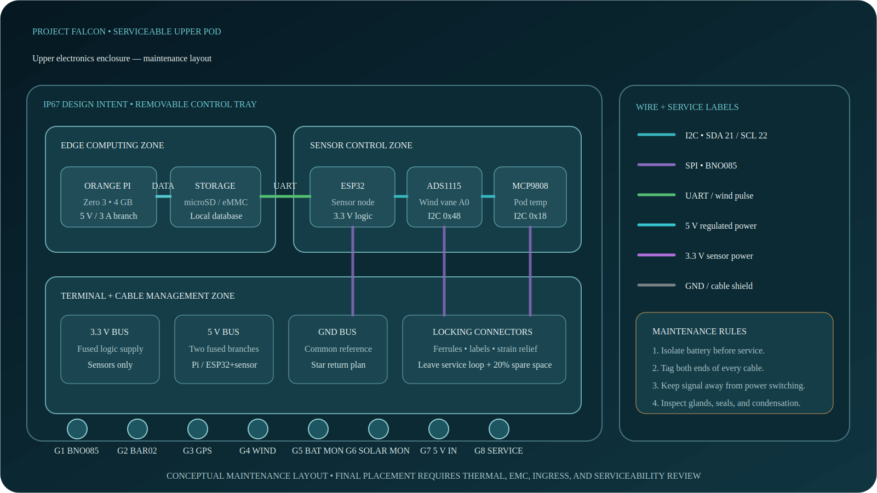
MAINTAINABLE ENCLOSURE
06
The upper pod organizes electronics and labeled cables
PROJECT FALCON • FULLBRIGHT COLLEGE
DOST IDEA PRESENTATION
Notes:
The upper box is the serviceable electronics pod. A removable tray separates the Orange Pi edge-computing zone from the ESP32 sensor-control zone. Terminal blocks organize the 3.3-volt, regulated 5-volt, and common-ground buses. Every cable enters through an identified gland and is labeled at both ends. Signal wiring is routed away from power switching. Battery power must be isolated before maintenance. Final placement still requires thermal, electromagnetic-compatibility, ingress, and serviceability testing.

Slide 7
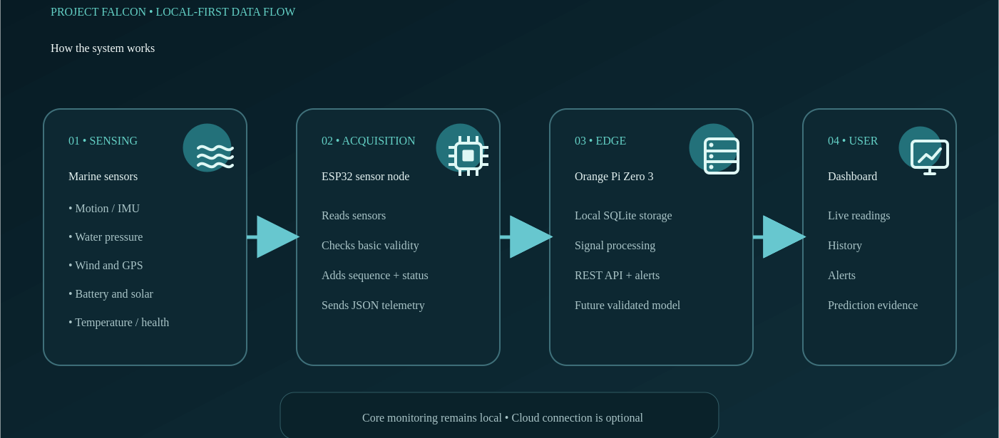
SYSTEM WORKFLOW
07
Sensors measure; ESP32 collects; Orange Pi explains
PROJECT FALCON • FULLBRIGHT COLLEGE
DOST IDEA PRESENTATION
Notes:
First, the sensors collect measurements. The ESP32 reads, checks, and packages the values as telemetry. USB or UART carries the data to the Orange Pi, which manages local storage, signal processing, APIs, alerts, and future model inference. The dashboard then presents current readings, history, alerts, and evidence. Core monitoring remains local, so constant cloud access is not required.

Slide 8
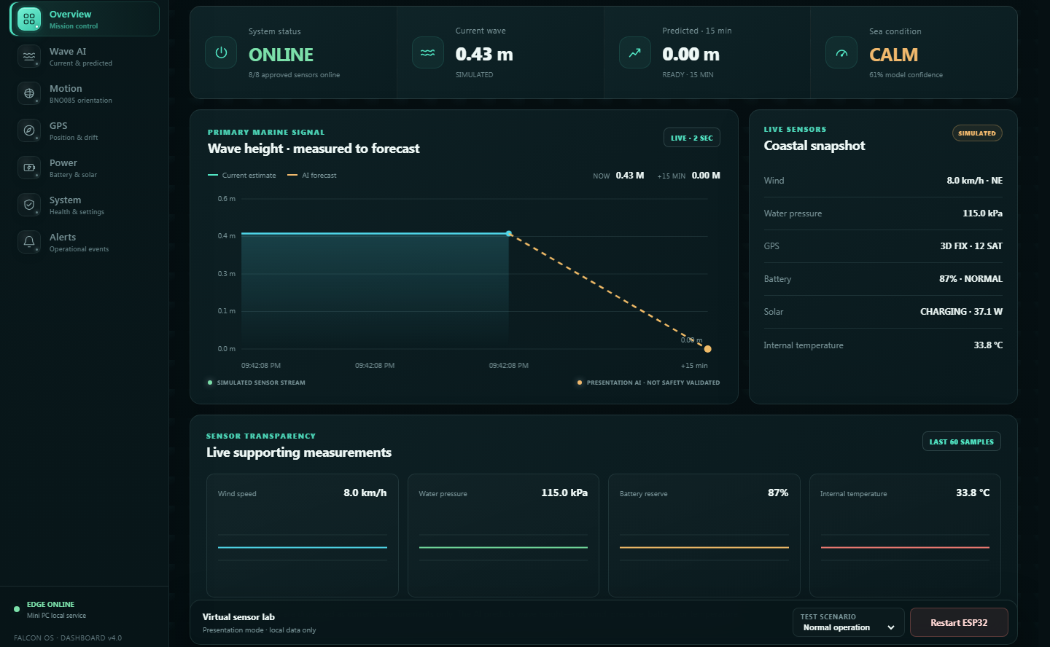
CURRENT PROGRESS
08
A working software concept—not yet a field-validated buoy
✓
Already working
Responsive dashboard
ESP32 firmware foundation
Telemetry contract + simulator
Python edge API + local database
Alerts and documentation
✓
Verified in software
Firmware builds successfully
18 edge-service tests pass
Dashboard production build passes
SIMULATED DATA • NOT FIELD MEASUREMENTS
PROJECT FALCON • FULLBRIGHT COLLEGE
DOST IDEA PRESENTATION
Notes:
FALCON is more than a drawing: we have a working dashboard, simulator, firmware foundation, telemetry contract, edge service, local database, alerts, wiring plan, BOM, and test documents. We are also transparent that the displayed data are simulated. Physical integration, calibration, field-trained AI, and marine deployment validation still require funded development.

Slide 9
INNOVATION
09
The contribution is responsible system integration
FALCON does not claim to invent the buoy, sensor, or AI algorithm.
◫
Affordable + modular
⌂
Local-first
◐
Transparent output
Student-scale architecture with replaceable, documented components.
Monitoring and storage continue without mandatory cloud dependence.
Measured, simulated, estimated, and predicted values are clearly distinguished.
FALCON's novelty is the validated integration and local adaptation of sensing, edge computing, energy, prediction, and protection subsystems.
PROJECT FALCON • FULLBRIGHT COLLEGE
DOST IDEA PRESENTATION
Notes:
Our contribution is not a claim that each component is new. The innovation is the practical, reproducible, and validated integration of sensing, edge computing, energy, prediction, and protection for a defined local use case. We also distinguish measured, simulated, estimated, and predicted values to avoid misleading users.

Slide 10
BENEFICIARIES
10
Start with one verified user and one pilot site
⚓
Coastal LGU / DRRM
◒
Fisherfolk / small craft
Localized observation history and equipment-status awareness.
Accessible near-shore information for a defined use case.
⌬
Schools / researchers
◎
Ports / tourism / NGOs
A reproducible platform and local dataset for future studies.
Potential monitoring support after validation and stakeholder confirmation.
PILOT PRINCIPLE: prove value for one stakeholder before expanding scope.
PROJECT FALCON • FULLBRIGHT COLLEGE
DOST IDEA PRESENTATION
Notes:
Potential users include coastal LGUs, fisherfolk, schools, researchers, ports, tourism operators, and environmental organizations. We will not claim that one prototype serves everyone. Before deployment, we will confirm one primary beneficiary, one Palawan site, and one realistic information need.

Slide 11
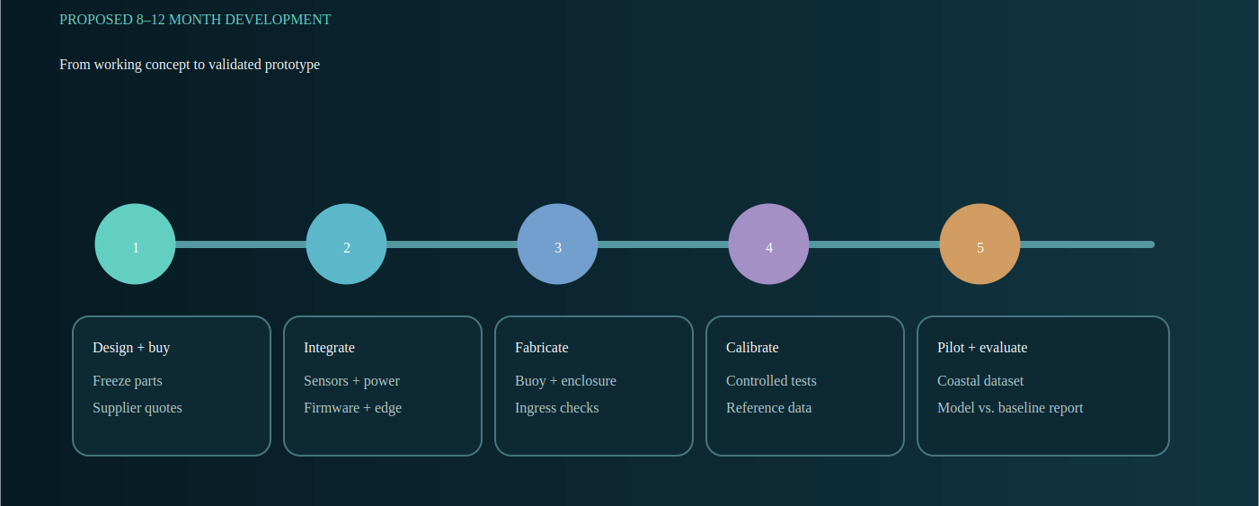
DEVELOPMENT PLAN
11
Build safely, collect evidence, then evaluate
ESTIMATED DEVELOPMENT: 8–12 MONTHS
PROJECT FALCON • FULLBRIGHT COLLEGE
DOST IDEA PRESENTATION
Notes:
Development follows a safe sequence: finalize design and procurement, integrate electronics, fabricate and seal the buoy, calibrate in controlled tests, conduct a supervised coastal pilot, train and compare the model with a baseline, then report the results. The estimate is eight to twelve months, subject to procurement, weather, permits, and data requirements.

Slide 12
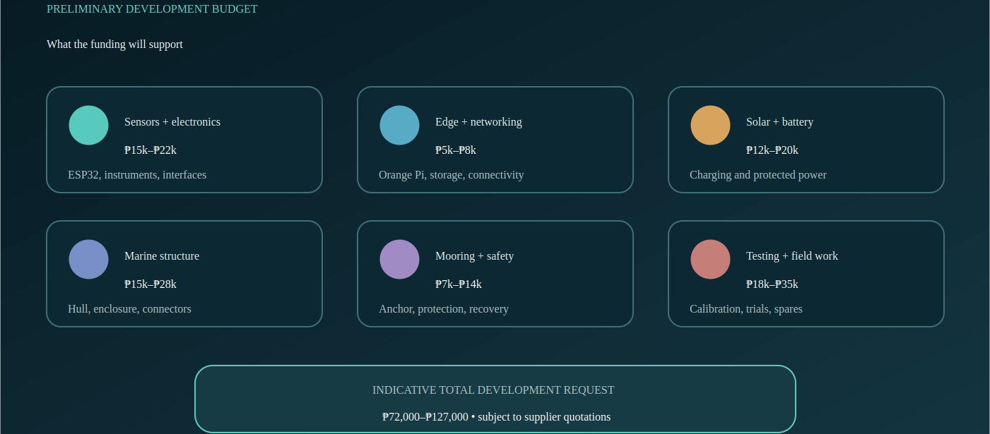
PRELIMINARY BUDGET
12
Funding supports the complete development process
PROJECT FALCON • FULLBRIGHT COLLEGE
DOST IDEA PRESENTATION
Notes:
The preliminary request is seventy-two thousand to one hundred twenty-seven thousand pesos. It covers electronics, edge computing, solar and battery power, marine structure, mooring, safety, calibration, field work, spares, transport, and contingency. This is a planning range and must be replaced by current supplier quotations before procurement.

Slide 13
EXPECTED RESULT + REQUEST
13
Turn the working concept into a validated physical prototype
✓
Deliverables
Integrated physical prototype
Calibrated sensing and power
Local dashboard and data archive
Controlled + supervised coastal results
Model-versus-baseline evaluation
Reproducible technical documentation
→
Support requested
Component procurement • fabrication • calibration access • supervised field testing • technical mentorship
We are asking for the opportunity to generate local evidence—not acceptance of an untested operational forecast.
CONCEPT VISUALIZATION
PROJECT FALCON • FULLBRIGHT COLLEGE
DOST IDEA PRESENTATION
Notes:
At the end of funded development, we aim to deliver one integrated and documented prototype, calibrated sensors and power, local dashboard and archive, supervised coastal-test results, baseline-versus-model evaluation, and technical reports. We request support for procurement, fabrication, calibration access, field testing, and mentorship. We are asking for the opportunity to generate evidence—not acceptance of an untested forecast. Thank you.

